Slide 1
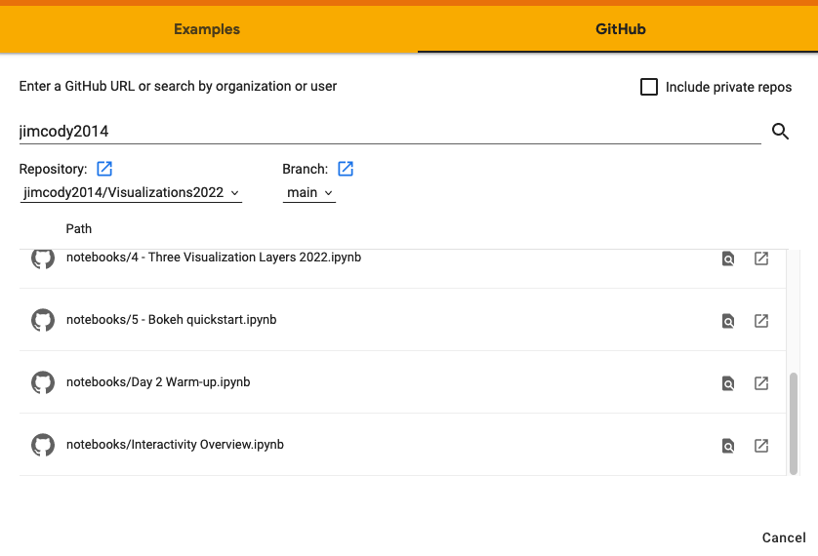
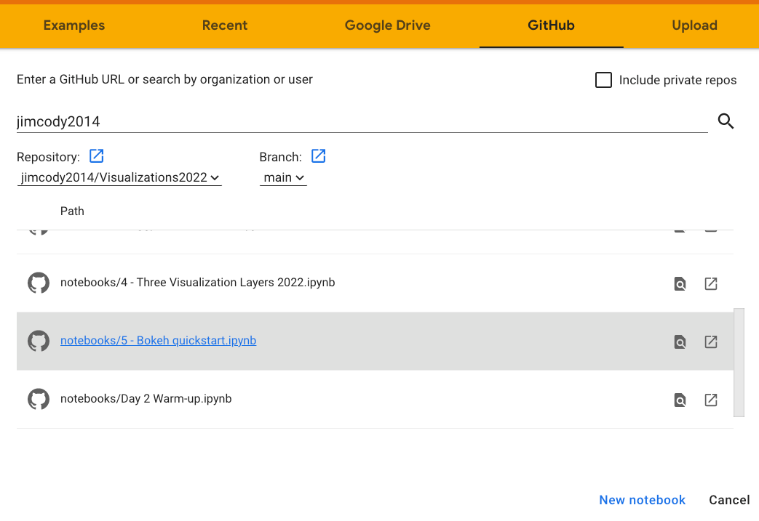
Go to CoLab (https://colab.research.google.com/)
Sign in
If box with orange band does not appear…
From the menu bar select File > Open Notebook.
Go to the Github tab
Search for jimcody2014
Scroll down to find the notebook needed

